Slide 1

Title:Smart Diet Planning and Tracking System
Student Name: Kuppannagari Sai Joshna
Student ID: 2520030293
Cluster:3
Section: 11
Under the Guidance
of
Supervisor Name: TSP Madhuri
Assistant Professor
Department of CSE

Slide 2
OUTLINE
Abstract
Existing System
Proposed System
System Architecture
Project Modules
Objectives
Co’s Attainments - FWD
Co1
Co2 …….. 5. Co5
Co’s Attainments - DSA
Co1
Co2 …….. 5. Co5
Screen Shots for FWD & DSA
Conclusion
Geo-Tagged Photos

Slide 3
Abstract
Diet Planning and Tracking System is a Java-based web application for easy nutrition tracking.
It uses Java to handle the main logic and ensure smooth performance.
HTML builds the structure of the web pages, while CSS makes them visually appealing.
JavaScript adds interactivity, making tools like calorie calculators dynamic.
The app begins as a simple calorie calculator and grows into a dashboard for meal tracking.
Advanced features like smart meal planning and multi-user support make it a complete health tool.

Slide 4
Existing System
Current methods for tracking nutrition generally fall into two categories, both of which have significant flaws:
Manual Tracking: Using paper journals or mental math. This is tedious, prone to calculation errors, and lacks any visual feedback.
Commercial Apps: Large platforms (e.g., MyFitnessPal) are often bloated with ads, require paid subscriptions for core features, and pose privacy risks regarding personal health data.
The Gap: Most current tools focus on mass-market data collection rather than providing a simple, ad-free experience for personal growth.

Slide 5
Proposed System
Smart CaloTrack is a lightweight, Java-based web application designed to provide a fast, private, and free alternative.
Precision: Replaces manual estimates with automated, scientifically-backed Java logic for calorie targets.
Privacy & Speed: A minimalist, ad-free interface that ensures user data stays private while allowing for quick meal logging.
Scalability: Built on a modular 4-phase architecture, the system evolves from a simple calculator into a full-featured health dashboard.
Goal-Oriented: It provides immediate, actionable feedback to help users reach weight loss or muscle gain targets without unnecessary complexity.

Slide 6
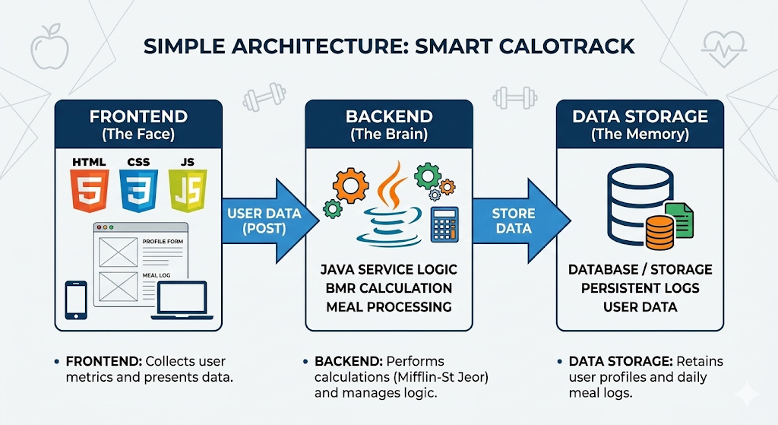
System Architecture
Frontend: HTML/CSS/JS forms collect user data and display results.
Request: Data travels to the server via standard HTTP requests.
Backend: Java logic calculates calorie goals and processes meal logs.
Database: Securely stores user profiles and persistent history.

Slide 7
Project Modules
User Profile: Captures biometric data and activity levels for personalized tracking.
Calculation Engine: Java logic that computes daily calorie targets using BMR formulas.
Meal Logger: An interactive form for recording daily food intake and calorie counts.
Nutritional Analytics: Visualizes progress and intake trends using JavaScript charts.
Smart Suggestions: Generates tailored meal plans based on user-specific fitness goals.
Data Persistence: Manages secure storage of user history and profile information.

Slide 8
Objectives
Automate Calculations: Use Java logic to provide instant, accurate calorie targets based on user biometrics.
Simplify Tracking: Create a minimalist, ad-free interface for fast and easy daily meal logging.
Ensure Privacy: Keep user health data secure and private, avoiding the data-mining of commercial apps.
Visualize Progress: Provide clear, interactive dashboards to track fitness goals and nutritional trends.
Enable Scalability: Build a modular foundation that allows for future enhancements like AI meal planning.

Slide 9
Co’s Attainments - FWD
CO | Syllabus Topic | How Smart Diet Planner Achieves It
CO1 | HTML & CSS | Uses semantic HTML structure with advanced CSS including linear gradients, custom typography, and box-shadows.
CO2 | Forms & Layouts | Implements multi-step forms with validation and utilizes Flexbox for dynamic meal list and card layouts.
CO3 | JS Fundamentals | Implements calorie logic via arrow functions, array methods (forEach), and conditional health status branching.

Slide 10
CO | Syllabus Topic | How Smart Diet Planner Achieves It
CO4 | DOM & Storage | Features dynamic UI rendering for logs/progress bars and uses localStorage for session and user profile persistence.
CO5 | Advanced Web Dev | Integrates the Chart.js API for visual data analytics and follows a deployable Single-Page Application (SPA) structure.

Slide 11
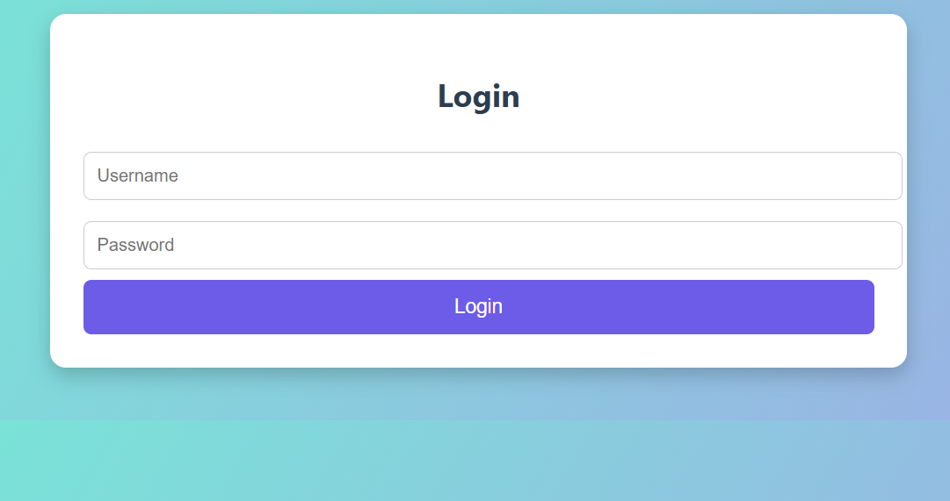
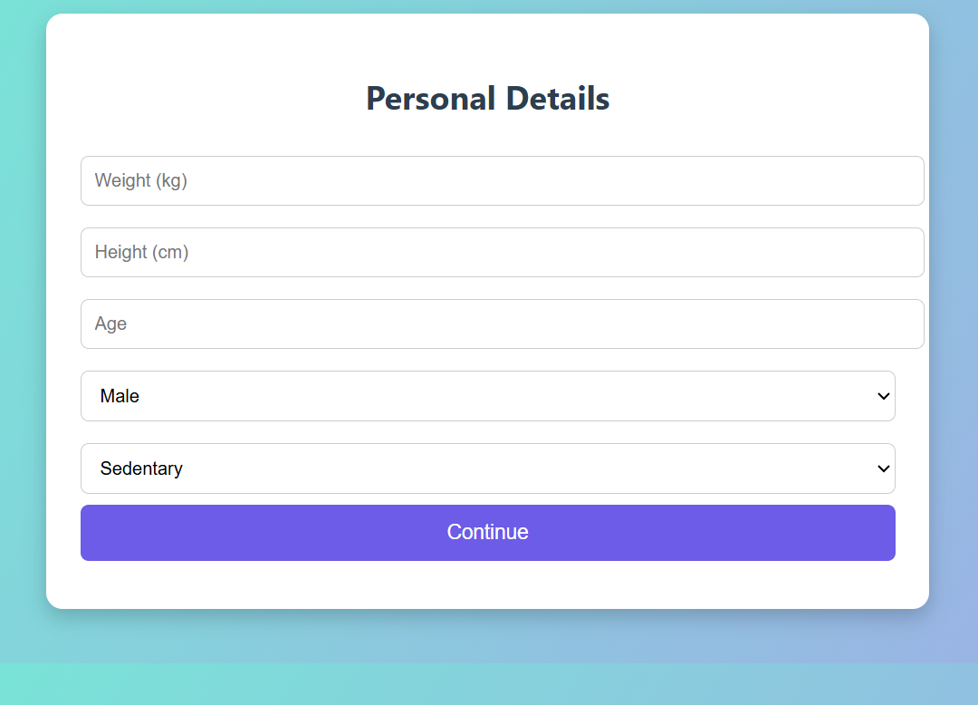
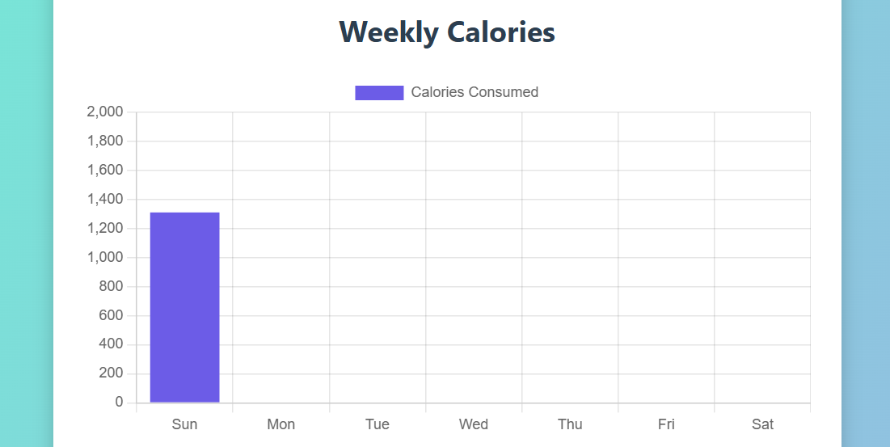
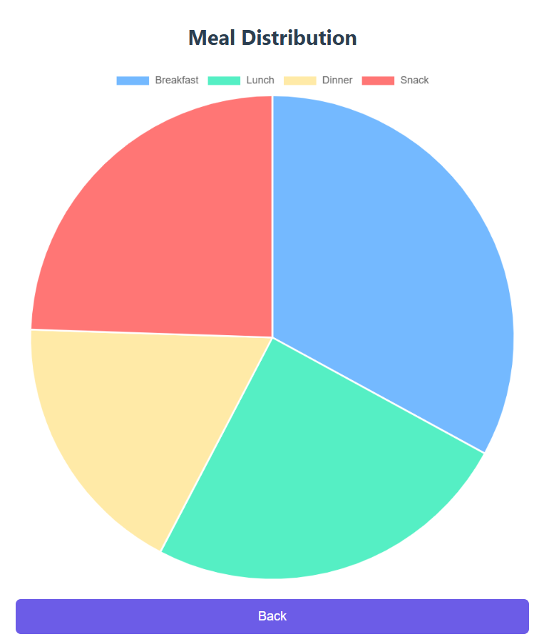
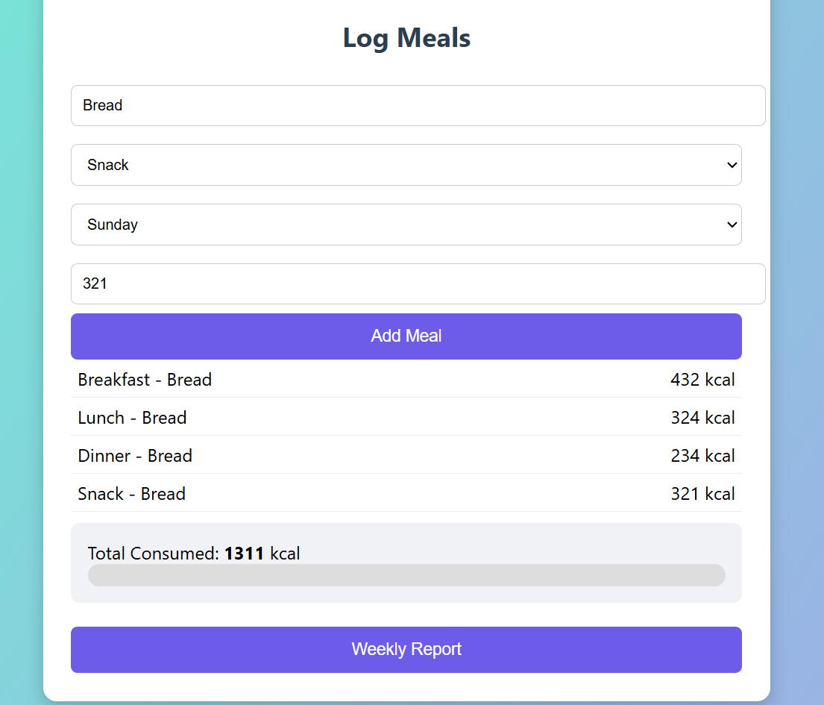
Screenshots for FWD & DSA

Slide 12
Conclusion
The Smart Diet Planner is a web-based project built using HTML, CSS, and JavaScript. It provides BMI calculation, calorie tracking, and weekly reports with interactive charts. The project maps effectively to all course outcomes (CO1–CO5), covering design, forms, interactivity, storage, optimization, and deployment. It demonstrates practical application of syllabus concepts while offering real-world utility. Overall, the system is simple, user-friendly, and academically aligned, making it a strong showcase project.

Slide 13
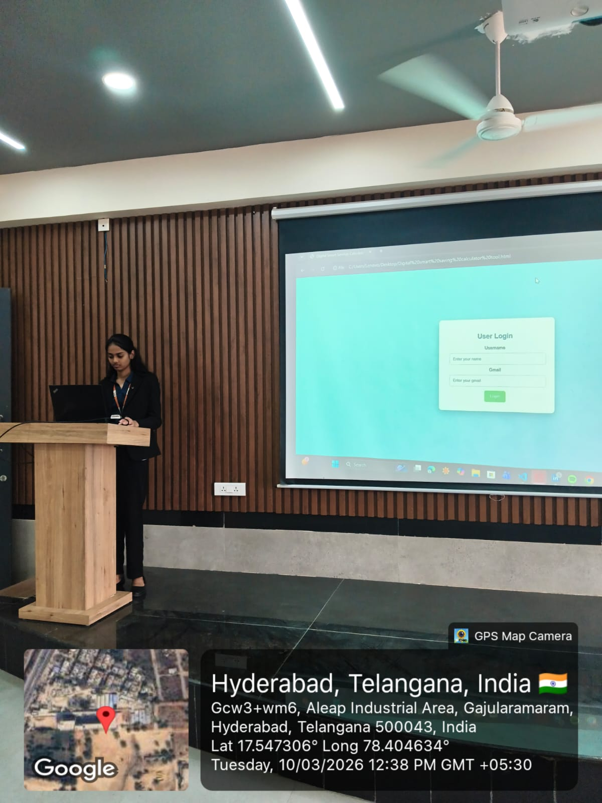
Geo- Tag Photos

Slide 14
THANK YOU

